Slide 1

AI-Powered Predictive Maintenance System
MANUFACTURING ANALYTICS CAPSTONE PROJECT
Predicting milling-machine failures from operating data
Shivam Kumar Rajput
Notes:
Introduce the project: a machine-learning system that predicts whether a milling machine will fail, using routine operating readings, so maintenance can be planned instead of reactive.

Slide 2




Unplanned downtime is costly
The question
Can routine operating readings predict a machine failure before it happens — and which readings matter most?
Production stops
Maintenance cost
Line downtime and idle labour
Emergency repairs, rushed parts
Reactive repair and fixed-schedule service both waste time or miss failures. Predictive maintenance targets the machines that need attention.
Delivery delays
Lower OEE
Missed customer commitments
Availability and productivity drop
Notes:
Unexpected failures stop production, raise maintenance cost, delay deliveries and lower OEE. The project question is whether operating data can warn us in advance.

Slide 3
The data at a glance
10,000
6
339
5
machine records
predictors
failures (3.39%)
failure modes
Predictors used
Product type
Air temp
Process temp
Rotational speed
Torque
Tool wear
AI4I 2020 dataset (Matzka, 2020): synthetic, modelled on a real milling machine. No missing values, no duplicates.
Notes:
AI4I 2020 dataset: 10,000 rows, 339 failures. Only 3.4% of records are failures, which makes the problem imbalanced. Six predictors are used; the failure-mode flags are used for analysis only because they define the target.

Slide 4






Our approach
1 Understand
2 Explore
3 Prepare
Quality checks, target balance
EDA, bivariate, correlation
Encode, 80/20 split, scale
4 Model
5 Evaluate
6 Act
Six classifiers, grid-search tuning
Precision, recall, F1, ROC
Explain, recommend, dashboard
Notes:
Same data split and preprocessing for every model so that the comparison is fair.

Slide 5
Failed machines work harder
Torque
50.2 Nm
vs 39.6 Nm normal
Tool wear
144 min
vs 107 min normal
Temperature differences are small — mechanical load and tool condition carry the signal.
Notes:
Failed machines run at about 27% higher torque and 35% higher tool wear. Speed is slightly lower and temperatures barely differ. Mechanical variables are better predictors than environmental ones.

Slide 6
Each failure mode has a signature
Mode | Operating signature
TWF | Tool wear ≈ 216 min
HDF | Torque 53 Nm, speed 1,337 rpm, warmer air
PWF | Highest speed, 1,764 rpm
OSF | Torque 58 Nm and wear ≈ 208 min
RNF | No clear signature
Modes can overlap, so counts exceed the 339 failed records. One threshold cannot catch all of them.
Notes:
Heat dissipation is the most common mode (34% of failures), then overstrain and power failure. Each mode appears under different operating conditions, which is why a model that looks at several readings together is needed.

Slide 7
Why accuracy misleads
Precision
96.6%
Of machines flagged, how many truly fail — limits false alarms
Recall
accuracy of a model that always says “no failure”
Of real failures, how many we catch — limits missed breakdowns
Failures caught: 0
F1-score
Balance of the two — our tuning objective
Notes:
Only 3.39% of the records are failures, so a model that never predicts a failure is 96.6% accurate. We judge models on failure-class precision, recall and F1.

Slide 8
Six models, tuned and compared
Model | Accuracy | Precision | Recall | F1
Logistic Regression* | 96.80% | 0.67 | 0.12 | 0.20
KNN* | 97.25% | 0.81 | 0.25 | 0.38
Tuned Decision Tree | 98.55% | 0.79 | 0.78 | 0.79
Random Forest | 98.50% | 0.88 | 0.65 | 0.75
Tuned SVM | 98.05% | 0.75 | 0.63 | 0.69
Tuned Gradient Boosting | 98.60% | 0.84 | 0.72 | 0.78
GridSearchCV with F1 objective · stratified 80/20 split · 68 failures in the 2,000-record test set
* baseline results; tuned KNN (K = 5): P 0.83, R 0.29, F1 0.43. Tuned Logistic Regression: P 0.64, R 0.13, F1 0.22.
Notes:
All models exceed 96% accuracy, so accuracy cannot separate them. The tuned Decision Tree has the highest recall and F1, Gradient Boosting the highest accuracy, Random Forest the highest precision. Logistic regression with class_weight=balanced reached recall 0.84 but accuracy fell to 82%, which shows the precision-recall trade-off.

Slide 9
Failure detection by model
Tuned Decision Tree
Best recall (0.78) and F1 (0.79)
Tuned Gradient Boosting
Best accuracy (98.60%), F1 0.78
Random Forest
Best precision (0.88), fewer alarms
Notes:
Logistic regression and KNN miss most failures. The three strongest models are close; the Decision Tree catches the most failures while remaining interpretable.

Slide 10
Selected: tuned Decision Tree
Test set (2,000 machines)
Predicted normal
Predicted failure
98.55%
79.1%
Actual normal
1,918
14
Accuracy
Precision
77.9%
78.5%
Actual failure
15
53
Recall
F1-score
Why this model
Best recall and F1 of all models
Rules engineers can read and trust
Generalises: 99.0% train vs 98.6% test
Notes:
Hyper-parameters: Gini criterion, max depth 10, min samples per leaf 4. On the test set it caught 53 of 68 failures with 14 false alarms and 15 missed failures. The test set is small, so the gap to Gradient Boosting (49 caught) should be confirmed with more data.

Slide 11
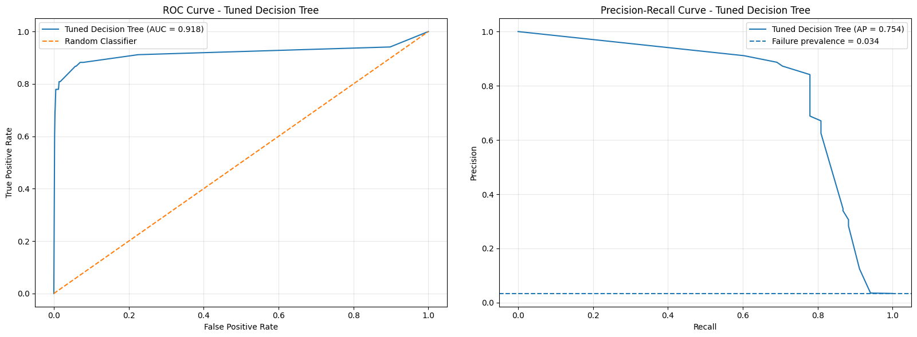
It ranks risky machines well
0.918
ROC-AUC
0.754
Left: ROC curve · Right: precision–recall curve
Average precision
Average precision is over 20× the baseline — the benchmark that matters for rare failures.
vs 0.034 failure prevalence
Notes:
ROC-AUC of 0.918 shows strong ranking ability. For imbalanced data, average precision against the 3.4% prevalence is the more meaningful benchmark.

Slide 12
What drives the predictions
Torque dominates
The strongest signal by a wide margin
Tool wear is second
Consistent with the failure-mode analysis
Product type barely matters
Temperatures play a minor role
SHAP shows what the model relies on — an association, not proof of physical cause.
Notes:
SHAP was applied to the tuned Decision Tree. Torque and tool wear dominate. A local explanation for machine 1391, a correctly predicted failure, showed torque contributing +0.857 and tool wear +0.071.

Slide 13
From prediction to action
Sensor readings
›
Failure model
›
Risk flag
›
Maintenance action
Signal | Recommended action
Failure predicted | Priority inspection and preventive maintenance
High tool wear | Inspect or replace the tool
High torque | Check mechanical load
Abnormal speed | Investigate operating conditions
High temperature | Check cooling and thermal conditions
A prediction is a risk signal, not a confirmed failure — engineering inspection decides.
Notes:
The model was saved with joblib and wrapped in a reusable function. On the test set the Gradient Boosting risk classification flagged 58 of 2,000 machines as Failure Risk. The final framework uses the Decision Tree.

Slide 14
Scenario testing
Scenario 1
0.04%
35 Nm · 50 min wear · 1,550 rpm
Scenario 2
0.34%
55 Nm · 180 min wear · 1,400 rpm
Scenario 3
50.0%
60 Nm · 220 min wear · 1,800 rpm
Tree-leaf probabilities are not calibrated real-world failure rates.
Notes:
Three hypothetical machines show risk rising with torque and tool wear. Decision Tree probabilities are based on training samples in each leaf, so they are indicative only.

Slide 15
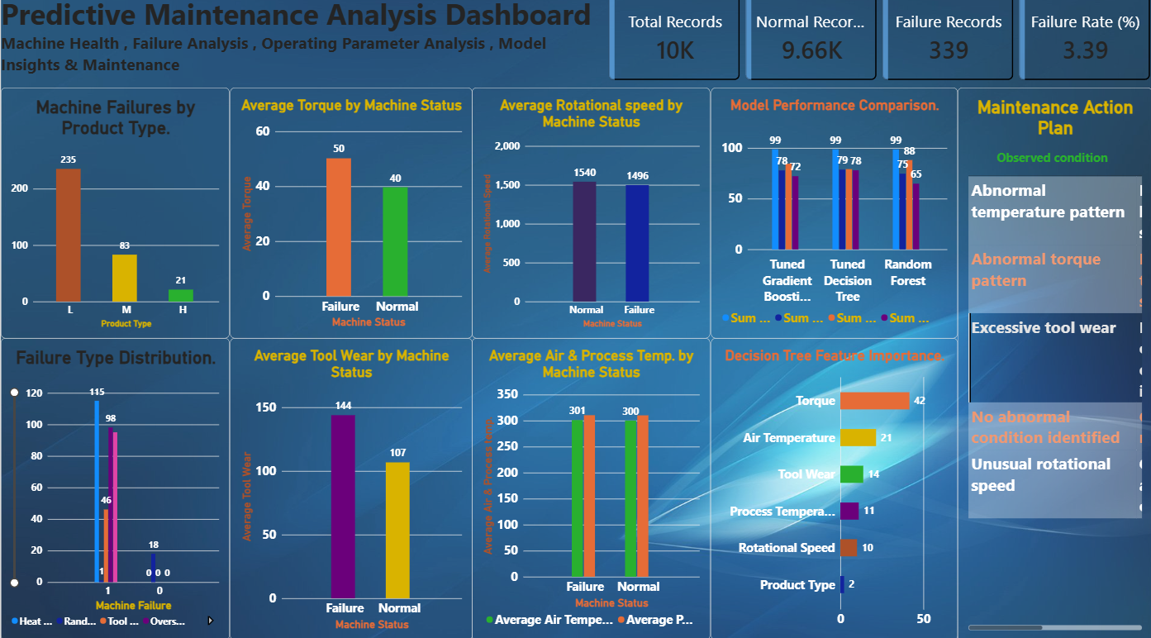

Power BI Dashboard
Machine health
Failure rate 3.39%, failures by product type
Operating parameters
Normal vs failed torque, wear, speed, temperature
Insights and actions
Model comparison and maintenance plan
Model insights and maintenance action plan
Notes:
Three dashboard pages for non-technical users: machine health and failure analysis, operating parameter analysis, and model insights with the maintenance action plan.

Slide 16
Limitations and next steps
Limitations
Next steps
Synthetic data, not a real plant
Only 68 failures in the test set
15 of 68 failures still missed
Probabilities are not calibrated
Six sensors, no vibration or history
Validate on real machine data
Class weighting and threshold tuning
Add vibration and maintenance history
Live monitoring and workflow integration
Monitor and retrain after deployment
Notes:
Be explicit about limitations: the dataset is synthetic and the test set is small. The model is decision support, not a replacement for inspection.

Slide 17
Key takeaways
3.4%
Torque + tool wear
of records are failures, so recall and F1 matter more than accuracy
are the strongest failure signals
98.55%
Decision support
accuracy, 0.78 recall and 0.79 F1 for the tuned Decision Tree
not a replacement for engineering inspection
Thank you — questions?
Notes:
Close with the four takeaways and invite questions.

